Slide 1

Cloud Computing - Challenges, Risk, and Mitigation
Module Number: 04
Module Name: Cloud Computing - Challenges, Risk, and Mitigation
Version Code: CC1
Released Date: 18-Jul-2018

Slide 2
Cloud Computing - Challenges, Risk, and Mitigation
AIM:
The aim of this module is to help students understand the challenges and risks involved and the mitigation steps in moving to cloud.

Slide 3
Cloud Computing - Challenges, Risk, and Mitigation
Objectives:
The Objectives of this module are:
To explain the important considerations when moving to cloud.
To explain designing a cloud proof of concept.
To discuss the risks and consequences of cloud computing.

Slide 4
Cloud Computing - Challenges, Risk, and Mitigation
Outcome:
At the end of this module, you are expected to:
Outline the important considerations when moving to cloud.
Outline the important considerations when designing a cloud proof of concept.
Identify the risks and consequences of cloud computing.

Slide 5
Cloud Computing - Challenges, Risk, and Mitigation
Contents
Cloud Storage
Application performance
Data Integration
Security
Ensuring Successful Cloud Adoption
Designing a Cloud Proof of Concept
Vendor roles and capabilities
Moving to the cloud
Impact of Cloud on IT Service Management
Risks and Consequences of Cloud
Computing
Legal Issues
Compliance Issues
Privacy and Security

Slide 6
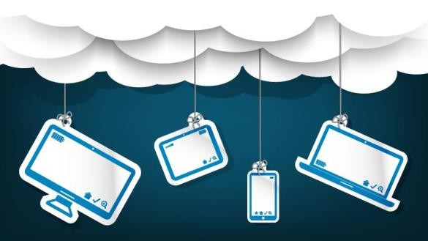



Cloud Computing - Challenges, Risk, and Mitigation
Moving to Cloud – Important Considerations
Cloud Storage
Application Performance
Data Integration
Cloud Security

Slide 7
Cloud Computing - Challenges, Risk, and Mitigation
Cloud Storage
Cloud storage is a service model in which data are maintained, managed, backed up remotely, and made available to users over a network.
Payment is generally on a per-consumption, monthly rate.
Although the per-gigabyte cost has been radically driven down, cloud storage providers have added
operating expenses that can make the technology more expensive than users bargained for.
The most commonly used cases are cloud backup, disaster recovery, and archiving infrequently accessed data.
Organizations also use cloud storage services for DevOps as a capital cost-cutting measure. They can just spin up the compute and storage resources for the duration of the project and then spin them down when it ends.
There are three main cloud-based storage architecture models:
Public cloud storage
Private cloud storage
Hybrid cloud storage

Slide 8
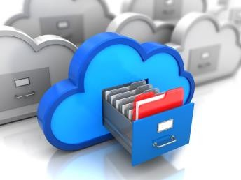
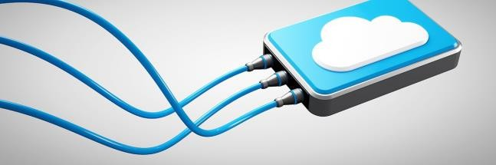
Cloud Computing - Challenges, Risk, and Mitigation
Cloud Storage
Public Cloud Storage
Public storage services provide a multi-tenant storage environment that is most suited for unstructured data.
Data are stored in global data centers with storage data spread across multiple regions or continents.
Customers generally pay on a per-use basis similar to the utility payment model.
Examples include Amazon Simple Storage Service (S3), Amazon Glacier for cold storage, Google Cloud Storage, Google Cloud Storage Nearline for cold data and Microsoft Azure.
Private Cloud Storage
Private cloud, or on-premise, storage services provide a dedicated environment protected behind an organization's firewall.
Private clouds are appropriate for users who need customization and more control over their data.

Slide 9
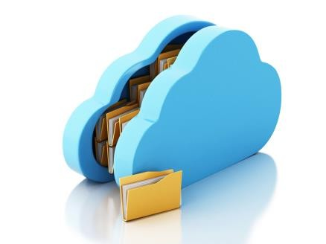
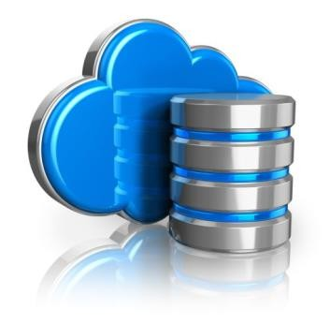
Cloud Computing - Challenges, Risk, and Mitigation
Cloud Storage
Hybrid cloud
Hybrid cloud is a mix of private cloud and third-party public cloud services with orchestration between the
platforms for management.
The model offers businesses flexibility and more data deployment options.
An organization might, for example, store actively used and structured data in an on-premises cloud, and unstructured and archival data in a public cloud.
Despite its benefits, a hybrid cloud presents technical, business and management challenges. For example, private workloads must access and interact with public cloud storage providers, so compatibility and solid network connectivity are very important factors.
An enterprise-level cloud storage system should be scalable to suit current needs and accessible from anywhere.

Slide 10
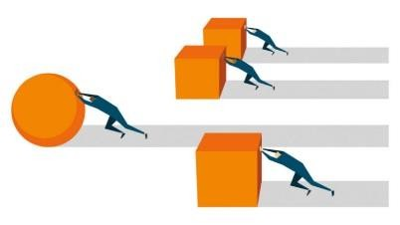
Cloud Computing - Challenges, Risk, and Mitigation
Application Performance
Managing application performance in cloud:
Make sure the application is right for cloud – Not every application performs well in the cloud so it is critical to
check the suitability before migration.
Define business requirements - The business requirements for performance standards such as availability, reliability, response times, etc. should be defined and communicated properly.
Seek a unified view across the hybrid environment - In order to proactively manage service quality and diagnostics, enterprises need to focus on monitoring cloud-enabled business processes from end to end – by creating a single, unified view across private cloud, public cloud, and traditional services in a way that provides near real-time visibility into business processes to deliver the optimal user experience.
Deploy analytics for holistic visibility – Enterprises may have multiple silos, platforms, and vendors, each of these should be monitored and all the data should be correlated to detect anomalies before they impact any critical application.

Slide 11
Cloud Computing - Challenges, Risk, and Mitigation
Application Performance
Impact of infrastructure resources on the application – Considering the infrastructure requirements of the application necessary, being able to correlate infrastructure resources to the applications they support, monitor those resources and measure key performance indicators will not only ensure application performance but also enable predictive performance management in the cloud.
Focus on transaction - Focusing on the actual end-user transaction experience allows the business to clearly understand and manage service delivery as the transaction traverses the service delivery infrastructure.
Monitor performance from the end-user perspective
Understand the virtual platform – An application on cloud can face unfamiliar problems such as dealing with the hypervisor and at the storage level IT should use APM products to identify bottlenecks caused by these and other components, and solve the root issues on the virtual platform.
Automate the management process.
Manage work load and resources in real time.

Slide 12

Cloud Computing - Challenges, Risk, and Mitigation
Data Integration
Data storage in a SaaS solution is done by the service provider. Due to this, if you are migrating an existing application to a SaaS application, you need to work with the vendor to plan how data will be migrated from the current on-premises solution to the new SaaS solution.
Data integrity demands maintaining and assuring the accuracy and completeness of data. A data owner always expects that her or his data in a cloud can be stored correctly and trustworthily. It means that the data should not be illegally tampered, improperly modified, deliberately deleted, or maliciously fabricated.
If any undesirable operations corrupt or delete the data, the owner should be able to detect the corruption or loss. Furthermore, when a portion of the outsourced data is corrupted or lost, it can still be retrieved by the data users.

Slide 13

Cloud Computing - Challenges, Risk, and Mitigation
Cloud Security
Cloud security has to be a part of your company’s overall security strategy. Most companies place a high priority on the testing and monitoring of threats to their data center, buildings, people, and information.
Security concerns associated with cloud computing fall into two broad categories:
Security issues faced by cloud providers (organizations providing software, platform, or infrastructure as a service via the cloud).
Security issues faced by their customers (companies or organizations who host applications or store data on the cloud).
However, the responsibility is shared. The provider must ensure that their infrastructure is secure and that their clients’ data and applications are protected, while the user must take measures to secure their applications by using strong passwords and authentication measures.

Slide 14
Cloud Computing - Challenges, Risk, and Mitigation
Cloud Security
Security issues faced by cloud providers:
When an organization opts to store data or host applications on the public cloud, it loses the ability to have physical access to the servers. The data are at potential risk from insider attacks. Therefore, cloud providers must ensure thorough background checks of all employees who have physical access to the servers.
To conserve resources and cut costs, cloud providers often store more than one customer’s data on the same server. This may result in a situation where one customer’s data becomes visible to the other. Cloud providers should ensure data isolation and logical storage segregation to handle such sensitive issues.
Cloud uses virtualization extensively which can give rise to more security concerns. Virtualization is an additional layer that should be properly configured, managed, and secured. For example, a breach in the administrator workstation with the management software of the virtualization software can cause the whole data center to go down or be reconfigured to an attacker's liking.

Slide 15

Cloud Computing - Challenges, Risk, and Mitigation
Cloud Security
Even when cloud operators have good security (physical, network, OS, and application infrastructure), it is the company’s responsibility to protect and secure applications and information.
Reducing Cloud Security Breaches:
Authenticate all people accessing the network.
Frame all access permissions so that users have access only to the applications and data that they have been granted specific permission to access.
Authenticate all software running on any computer—and all changes to such software.
This includes software or services running in the cloud. Your cloud provider needs to automate and authenticate software patches and configuration changes, as well as manage security patches in a proactive way. Why is this so important to understand? Many cloud service provider outages typically come from configuration mistakes. If a cloud provider does not update security, your intellectual property could be at risk.

Slide 16

Cloud Computing - Challenges, Risk, and Mitigation
Cloud Security
Formalize the process of requesting permission to access the data or applications. This applies to your own internal systems and the services that are required to put your data into the cloud.
Monitor all network activity and log all unusual activity. In most cases, you should deploy intruder-detection technology. Although your cloud services provider may enable you to monitor activities on its environment, you should have an independent view. This is especially important for compliance.
Log all user activity and program activity and analyze it for unexpected behavior.
Encrypt, up to the point of use, all valuable data that needs extra protection.
Regularly check the network for vulnerabilities in all software exposed to the Internet or any external users.

Slide 17
Cloud Computing - Challenges, Risk, and Mitigation
Ensuring Successful Cloud Adoption
Designing a Cloud Proof of Concept
Vendor roles and capabilities
Moving to the Cloud
Impact of Cloud on IT Service Management

Slide 18



Cloud Computing - Challenges, Risk, and Mitigation
Designing a Cloud Proof of Concept
Cloud computing gives businesses the opportunity for immediate launching of applications. When moving to
cloud use the following steps to design a proof of concept.
Pick the right application
Cloud is not a fit for every application, but every organization has some application for which it is a
good fit.
Keep it lightweight—30–60 days.
Keep it simple. Do not start with your hardest use case.
Decide if the architecture meets the needs of the application, not if it matches your data center.
And select an application that is a good fit for cloud's strengths: namely speed of deployment,
scalability, and ability to handle variable loads.
Good options for the first deployment are:
Web Application
Mobile Application
Big data
Batch Processing
Dev/test solutions
9

Slide 19

Cloud Computing - Challenges, Risk, and Mitigation
Designing a Cloud Proof of Concept
Treat your first deployment as a learning experience
The first application you code for the cloud should serve not only as a solution that meets a business need, but also as a learning experience.
Just creating the application is not your only goal—you want to learn things that you can use to establish good practices and help you improve your cloud development process.
Your cloud deployments will evolve along with your knowledge and expertise.
Consider how you will manage the application overtime.
Start with the simplest application and then test more complex ones.
9

Slide 20


Cloud Computing - Challenges, Risk, and Mitigation
Designing a Cloud Proof of Concept
Use a public cloud to evaluate the feasibility of cloud
Once you have zeroed in on an application to build in the cloud, your next decision is where to build it.
You have a choice of public clouds, such as Amazon Web Services' (AWS) Elastic Compute Cloud (EC2), Rackspace, Google Compute Engine (GCE), and Windows Azure, as well as a choice of private clouds based on OpenStack, CloudStack, and VMware vSphere.
Private clouds are a good choice for applications that require high flexibility, performance, increased security, and compliance.
Do not try to re-create your data center in the cloud
A cloud instance is not a virtual machine in the sky. You cannot simply move a virtual machine (VM) image to a cloud and expect it to work out of the box.
Traditionally, IT systems are built bottom up, starting from hardware, hypervisor, operating system, and finally the applications.
However, cloud reverses this stack focusing first on applications and based on their need the cloud infrastructure is selected.
9

Slide 21

Cloud Computing - Challenges, Risk, and Mitigation
Designing a Cloud Proof of Concept
Test against technical requirements
Once you have your PoC application running on a cloud you can start to refine it.
Test it for performance.
Ensure that it meets your security and compliance requirements.
Integrate support for it into your existing IT Service Management processes.
And when everything is running smoothly, you can consider developing more complex workloads.
The technical pitfalls to watch out for:
Storage Performance—consider stripping, sharding, and noSQL architectures
Shared Storage
Software Licensing
Network Flexibility—consider dynamic DNS
Security compliance
9

Slide 22

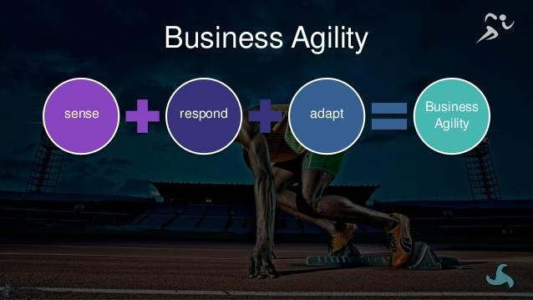
Cloud Computing - Challenges, Risk, and Mitigation
Designing a Cloud Proof of Concept
Cloud PoC Success metrics
The best measure of success of the PoC project is see if you are gaining the big-picture benefits.
Metric 1: Business agility—how quickly does the cloud help you respond to business needs and opportunities?
Speed and ease with which you can launch or change applications or services in the cloud.
Scale applications up or down to meet changing demand.
Offer services in new geographical areas with ease.
Being able to provide self-service IT to developers and business users.
9

Slide 23
Cloud Computing - Challenges, Risk, and Mitigation
Designing a Cloud Proof of Concept
Cloud PoC Success metrics
Metric 2: Improve Efficiency—Can make us more efficient with time and money?
Compare the costs—data center vs. cloud.
Evaluate opportunity costs—are there new opportunities with cloud which were not there
before?
Evaluate the time to plan, deploy, and manage applications.
Metric 3: Better Solutions—Can cloud help us deliver better solutions that meet customer needs.
Can I support new solutions that were difficult before such as web, mobile, gaming, big data, and batch processing?
Can I support better solutions which are highly scalable and geographically available.
9

Slide 24

Cloud Computing - Challenges, Risk, and Mitigation
Designing a Cloud Proof of Concept
Benefits of designing a Cloud PoC:
If you develop your cloud PoC you can implement new types of solutions with cloud that you could not implement at all without it, such as highly scalable applications for web, mobile, social, and gaming.
You can offer greater scalability and availability for your applications and minimize location-based latency to open up applications to users in a broader range of geographical areas.
Cloud can even enhance the availability of existing data centers by providing an on-demand disaster recovery environment.
9

Slide 25


Cloud Computing - Challenges, Risk, and Mitigation
Vendor Roles and Responsibilities
Once the decision to opt the cloud has been made, it is time to roll out the solution.
Cloud service rollout plans will vary depending on the type of cloud service used (SaaS, PaaS, or IaaS) and on the vendor.
One of the most important factors when deciding which vendor to use as a cloud service vendor is the
ability to negotiate the legal terms of the service agreement.
The service agreement must include a list of roles and responsibilities for both the customer and the cloud service vendor.
One of the key aspects of moving to the cloud is to provide access to data anytime, from anywhere, on any device, and to be able to dynamically scale.
Therefore, terms must be present in the service agreement to guarantee the delivery of those services and define what happens when the terms are not met.
9

Slide 26
Cloud Computing - Challenges, Risk, and Mitigation
Vendor Roles and Responsibilities
It is also important to understand that the vendor responsibilities vary depending on the type of cloud service being offered. SaaS vendors will have more responsibility over the service provided than PaaS vendors, and PaaS vendors will have more responsibility than IaaS vendors
Vendor Responsibility
SaaS
PaaS
IaaS
9

Slide 27




Cloud Computing - Challenges, Risk, and Mitigation
Negotiating Service Agreement
When negotiating the service agreement consider the following:
Contract renewals
Most vendors have an automatic contract renewal clause which are not suitable for larger organizations.
Contractual protection
An SLA usually describes the availability and services, and any penalties if the SLA is not met.
Beyond the SLA, organizations should look to ensure data access and privacy.
Get policies documented on data protection, security certifications, and application of rules and regulations.
Insurance
Even with the SLA and other assurances in place, it is recommended to have insurance coverage in case there is an interruption to the organization’s business due to the inability of the vendor to maintain the necessary service terms.
Some vendors will have insurance in place; others will not.
9

Slide 28


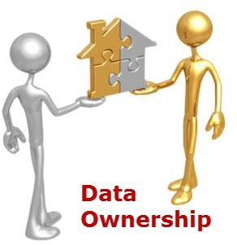
Cloud Computing - Challenges, Risk, and Mitigation
Negotiating Service Agreement
Data Loss
Data loss can be caused by either the vendor or the customer, depending on where and how data are stored.
The ability to have an in-house copy of the data must be discussed and added to the service terms.
Data Location
Data from the data centers are copied in different cities and even countries.
Different countries have different laws that govern where the data can be stored for services provided in that geographical span.
Both organizations and vendors should be aware of the regional laws and ensure they dealt with in
the service agreement.
Data Ownership
The data stored should be the property of the company, not the vendor.
The data should be protected from being used by the vendor or shared across other organizations.
Also terms should be included for the process of handing over the data to another vendor in case the
company decides to switch vendors.
9

Slide 29

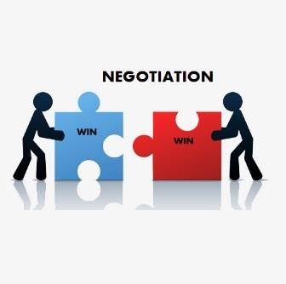


Cloud Computing - Challenges, Risk, and Mitigation
Best practices for negotiating cloud services contracts
The Cloud Industry Forum (CIF) developed a white paper in 2011 called ‘Cloud: Contracting Cloud Services, a Guide to Best Practice’ that discusses the best practices for negotiating cloud services contracts.
The following are best practices for negotiating a cloud service contract:
Choice of law
Organizations looking for a cheap or standard cloud service should contract under the vendor’s
standard terms, including the choice of law.
Other organizations should raise the issue of contract negotiation with the vendor and choose the law based on their territory coverage.
Data control
Vendors should disclose the list of data centers used to store the data, including backups.
The SLA between the vendor and the organization must also specify how backups are handled.

Slide 30
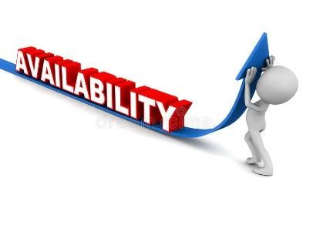



Cloud Computing - Challenges, Risk, and Mitigation
Service availability
Vendors should have documented management systems, processes, and resources.
Organizations should be able to access the average available time provided by the vendors in the different layers of services offered.
And consequences for not meeting the SLA must be clearly identified.
Liabilities and indemnities
Organizations should specify the purpose of contracting with the vendor so that it is clear that, unless the service adequately addresses this purpose, it is pointless to enter into the contract.
This purpose could be addressed in the SLA.
A vendor may offer an introductory period to enable the customer to evaluate the service before a full- term contract comes into effect.
Deletion of Data
Vendors should maintain a copy of the data being hosted even if the customer is not paying and not able to access the data.
Before data are deleted, the customer must be notified with enough time to resolve any existing disputes.

Slide 31



Cloud Computing - Challenges, Risk, and Mitigation
Moving to the Cloud – Cloud Challenges
Once the decision to embrace the cloud has been taken, organizations must chart out a detailed plan that marks their journey to the cloud. Listed below are the top challenges battled in a cloud environment by the cloud vendor, client as well as the end user.
Keeping up with security requirements:
Security tops the list of challenges when it comes to cloud computing as organisations lose their direct control over data. A cloud vendor must be aware of all security measures to be implemented while dealing with critical data and have them in place.
Obtaining the right knowledge and expertise:
With the advent of cloud computing, the role of the IT department has significantly changed and so as their need for knowledge and skills. Organizations must equip themselves with the required resources as well as the tools to implement robust cloud applications.
Choosing the right vendor:
Partnering with the right vendor is the key to success in the cloud. Organizations must follow a fail- safe mechanism in evaluating potential cloud vendors and ensure that they meet all security and privacy standards.
31

Slide 32




Cloud Computing - Challenges, Risk, and Mitigation
Moving to the Cloud – Cloud Challenges
Data interoperability and portability:
Organizations expand with time and their needs change rapidly. Therefore, additional caution must be practiced to avoid choosing a platform/technology/provider that makes the organization too dependent on them.
Budgeting difficulties while moving to the cloud:
The very nature of cloud is that it is scalable and is delivered on demand. This in turn may cause difficulties while drawing IT budgets for the entire organization. The fluctuating cost of cloud services is a very common challenge for small as well as medium-sized organizations.
Complexities while migrating to the cloud vary from one organization to the other. However, partnering with a reliable cloud service provider and planning ahead will deliver higher chances for optimized performance through the cloud.

Slide 33
Cloud Computing - Challenges, Risk, and Mitigation
Factors to Consider When Selecting a Cloud Solution
With so many options available, it’s easy to see that cloud-based enterprise solutions are definitely not all created equal, and many factors should be considered in the cloud software decision.
Delivery model flexibility
Ability to use the application on trial
Integration with other applications
Business process remodeling
Security
Platform/mobile compatibility
Backups and Recovery
Upgrades
Service level agreements
Training and Support
Scalability
Reference checks with existing customers
Vendor viability

Slide 34
Cloud Computing - Challenges, Risk, and Mitigation
Delivery model flexibility
With the many varieties of cloud delivery models out there, there are more choices but also more flexibility. Some cloud vendors offer the flexibility to change delivery models as business needs change—without modifications to configuration or the user interface.
First you must decide which type of cloud your company is best suited for, public or private, or a hybrid option offering private features in a public cloud.
Which service model to use – IaaS, PaaS or SaaS, is another decision companies have to make when selecting a cloud solution.
Ability to use the application on trial
Trial use is a feature unique to cloud deployment. It allows you to try an application before you even contact the vendor. Trying the application (with no contract agreements) can give you valuable insight into the application’s usability and interface, as well as a sense of how quickly and easily tasks can be performed.

Slide 35
Cloud Computing - Challenges, Risk, and Mitigation
Integration with other applications
If you have an understanding of the number of required integration points, and how the cloud vendor will integrate (whether through APIs or an integration server), this will give you an understanding of the likely length of the implementation process.
Business process remodeling
If using a public cloud, understand what kind of customization may be required based on desired internal business processes and see what possibilities are available with the cloud platforms being considered.
For example, on screen adjustments, non-source code customizations, or a certain level of business processes accommodation flexibility via pre-designed system logic may be possible but the source code cannot be modified.
Make sure to understand how workflows are created (point-and-click versus technical programming) with the various platforms being considered, and what kind of system integration and technical services are provided with the pricing model.

Slide 36
Cloud Computing - Challenges, Risk, and Mitigation
Security
Determine the layers of security that exist within the application and the data center. How will the cloud vendor protect your data from viruses, hackers, and theft?
Another important question to ask is whether or not a vendor has its own data center and cloud technology or uses one of the large providers, such as Amazon Web Services or Microsoft Azure. The advantage of going with one of the big providers is that other packages are also developed on these platforms, so companies may find it easier to integrate systems with each other, for example an ERP system with a CRM application. But using an in-house data center has benefits such as keeping company data close and being in control of updates and changes.
Platform/mobile compatibility
Make sure the cloud application is fully functional on the multiple operating systems and Web browsers that are likely in use at your organization. Also verify its accessibility via mobile devices if needed.
It is important to think about the future when it comes to compatibility as well. Is a mobile strategy included in the company’s IT strategy? How do the cloud applications under
consideration match with your organization’s future IT, web, and mobile needs?
36

Slide 37
Cloud Computing - Challenges, Risk, and Mitigation
Backups and Recovery
When evaluating a cloud provider, learn about its contingency, backup, and recovery plans and liabilities for both the platform and the data. Obviously these are important as with a cloud solution your data will more than likely be hosted off-site, and you want to be sure that your company’s data is safe and backed up with a reliable recovery plan in place.
Upgrades
Cloud vendors typically provide quicker response to innovation and new features, since deployment cycles are shorter than for on-premises applications. However, before signing the agreement you should ensure that these upgrades are indeed applied regularly and free of charge. Assess the vendor’s roadmap of product upgrades and determine how often they are expected.
Also, a test system or database should allow for playing with data, setup, and new upgrades/updates so the IT team is able to test new features or processes and detect any errors. Sufficient testing time should be granted to customers to test and adjust business processes along with the capabilities of the new version.
37

Slide 38
Cloud Computing - Challenges, Risk, and Mitigation
Service level agreements
Clear service level expectations must be documented within the service level agreement (SLA), including penalty clauses and conditions for undelivered services or unmet expectations. Make sure that the cloud vendor provides services beyond application delivery (e.g., business issues resolution, training, implementation support, and customer service).
Other points to be addressed in the agreement are:
Who owns the data (the vendor or the customer)
The procedure of getting the customer’s data back to the customer in the case of a subscription contract termination or expiration
How fast customer’s data change requests can be processed by the vendor
10. Training and Support
In order for the cloud software to be used by users to its fullest potential, training is required. Make sure the cloud provider has well-developed training programs. Along these lines, determine what kind of training is provided for new users, as well as for system upgrades. Also, ensure that the cloud provider can handle support enquiries if your organization runs into problems or has specific questions.
38

Slide 39
Cloud Computing - Challenges, Risk, and Mitigation
Scalability
Evaluate the cloud provider’s scalability through such infrastructure points as bandwidth, load balancers, servers and data warehouses.
Analyze its long- and short-term growth strategy and level of service. Will the cloud provider be able to maintain and improve service levels with the growth of its business and clients?
The vendor’s preliminary testing of the customer’s existing hardware and bandwidth along with providing technical recommendations on improving these are typically included in cloud software implementation projects.
Reference checks with existing customers
To evaluate a cloud provider’s ability to handle your organizational requirements, conduct reference checks with established clients that have been with the cloud provider for longer than contracted by initial terms. This will demonstrate whether the provider is effectively able to maintain its customer base. On-site visits can also be done, as these will help you see the technology in action, and get direct user feedback about the system and its provider.

Slide 40

Cloud Computing - Challenges, Risk, and Mitigation
Vendor viability
As many cloud vendors are relatively new players in the market, you should consider a cloud provider’s financial robustness.
Focus on revenue streams since pay-as-you-go revenues need to be maintained and venture capital (investors backing the company) to assess whether the vendor will be around and able to grow as your organizational needs grow.
Giving ample consideration to the above factors will help to ensure that your organization’s next cloud software purchase is its best-fit cloud solution, and a decision that the selection team can be confident of.

Slide 41
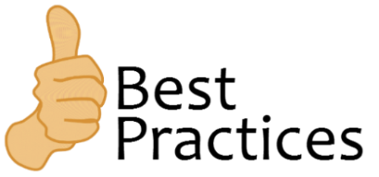
Cloud Computing - Challenges, Risk, and Mitigation
Best Practices to follow before Migrating to the Cloud
Finding the Right Vendor
To be able to reap the cloud cost benefits it is critical to choose the right vendor.
The following checklist can help organizations to best choose their cloud vendor:
Organizations that are looking to expand operations must pay attention to the user limit cap to avoid penalty charges as the number of users grow.
A service-level agreement that outlines the availability, performance, security measures, and
guaranteed uptime must be in place.
Partnering with more than one cloud vendor to satisfy all business needs is recommended. This makes the organization less prone to downtime issues.
The cloud vendor must allow customizable viewing and reporting of data rather than a proprietary format.
The cloud vendor must be able to provide customized workflows and user profiles with well-defined
role hierarchies. The cost and effort required to achieve these parameters must be determined.

Slide 42
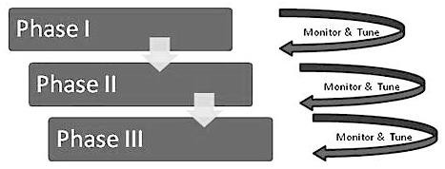
Cloud Computing - Challenges, Risk, and Mitigation
Best Practices to follow before Migrating to the Cloud
Phased-in Versus Flash-Cut Approaches
There are two approaches to moving to the cloud.
Flash-Cut approach wherein the cloud infrastructure and all the necessary tools and systems are built internally or by a vendor. Once the complete infrastructure, platform, and necessary software are ready, the migration is carried out completely at a stretch.
Phased-in approach where the migration is carried out in a phased manner, as and when necessary things are developed and commissioned.
A phased-in approach (where you do not have to move everything to the cloud at one single time) allows smoother transition as well as broader acceptance than in the other methods.

Slide 43
Cloud Computing - Challenges, Risk, and Mitigation
Best Practices to follow before Migrating to the Cloud
Evaluation of Cloud Service Agreement
Often cloud service agreements are only a way out of legal trouble for cloud providers,
while they should in reality be an assurance of high-level customer service. It is the responsibility of the cloud consumer to read and understand the service agreements in detail.
Key considerations to be included in the evaluation of cloud service agreements are:
Internal policies, processes, and culture that may influence cloud usage
Overall objectives and expectations from the cloud service
Trust and assurance through good governance
The metrics used to validate the service levels
Compensations in case of trouble
Limitations, disclaimers, and exclusions

Slide 44
Cloud Computing - Challenges, Risk, and Mitigation
Best Practices to follow before Migrating to the Cloud
Having a Contingency Plan
What if the cloud-based application crashes? What will you do if there is a hack?
What is the plan B if your cloud service provider goes bankrupt and hence not able to support your application anymore?
What happens if there is a security breach?
Situations like these are meant to arise especially in a cloud environment. It is extremely important to have a contingency plan in place to tackle such situations and a team always ready to implement recovery management within short notice. This could help the organization technically and financially and hence, saves the online reputation.

Slide 45

Cloud Computing - Challenges, Risk, and Mitigation
Practices to Avoid While Moving to the Cloud
Jumping in too Soon
The incredible benefits of cloud strongly attract organizations of all kinds and sizes. Adopting cloud technology is a great decision but it must be backed with the required homework.
Moving to the cloud does not imply purchasing a random solution with one card swipe. It requires the due diligence of a number of factors such as security, regulatory measures, business needs, cost analysis, etc.
Lack of Contingency Plan
Uncertainty is an indispensable part of conducting business.
Your cloud solution may encounter unexpected pitfalls such as natural calamities, vendor failure, business outage, unexpected costs, etc.
Moving to the cloud without a contingency plan is like setting oneself up for failure. Organizations must evaluate the various risks associated with the cloud and have a recovery plan in place before migrating to the cloud.

Slide 46
Cloud Computing - Challenges, Risk, and Mitigation
Practices to Avoid While Moving to the Cloud
Lack of Understanding the Business Needs
Is moving to the cloud the most viable option for your business organization?
The best place to start the cloud journey would be to evaluate the actual needs of the business and then map it onto the solutions available in the market.
Cloud customers must be able define the exact business case, the issues that must be solved and the ways in which they believe that moving to the cloud can help their organization.
Wrong Choice of Cloud Service Provider
Choosing the wrong cloud service provider is often the reason that prevents organizations from growing.
A reliable cloud service provider with a proven track record and with solutions that best suit the business needs has the highest chance of contributing toward organizational success.

Slide 47
Cloud Computing - Challenges, Risk, and Mitigation
Practices to Avoid While Moving to the Cloud
No due-diligence on Privacy and Data Security
Security and privacy concerns will exist forever. To ensure safe cloud operations, due diligence of security measures provided by the cloud vendor is mandatory.
Following is a list of security questions that you must ask your cloud vendor before giving the final nod:
Where does my data physically reside?
Do you hold any certification pertaining to data protection?
Will my data be encrypted? How do you plan to manage the encryption keys?
Who gets to access my data?
How does transition of data during the exit process work?

Slide 48
Cloud Computing - Challenges, Risk, and Mitigation
Practices to Avoid While Moving to the Cloud
Ignoring the Service-Level Agreements
A service-level agreement is a significant legal tool that determines how well the cloud experience turns out to be from the end-user perspective. It helps evaluate parameters such as cloud availability, quality of service, response time, capacity, etc. Ignoring these legal aids leads to misinterpreted
obligations and risks in the cloud.
Approving the Lowest Bidder
It is not wise to use cost as the only factor that influences the choice of vendor. The suitability of the cloud solution and the reliability of the vendor are important to avoid expensive mistakes in the cloud.

Slide 49


Cloud Computing - Challenges, Risk, and Mitigation
Moving to the Cloud—work to make the transition smooth
Moving to the cloud also involves understanding the impact it will have on your staff. It is important to anticipate issues and prepare well before introducing the new technology in the organization.
To smooth the transition to cloud consider the following steps:
Get executive support
The move to the cloud will be smoother if you have executive support. If one of these executives can
be designated the champion to send the message from the top, people will be more likely to listen.
Understand the culture
It is great if your culture is one that embraces innovation and change. However, if your company has been doing something one way for the last ten years, you need to understand that there will no doubt be some resistance. You need to plan your rollout accordingly.

Slide 50


Cloud Computing - Challenges, Risk, and Mitigation
Moving to the Cloud—work to make the transition smooth
Communicate the message
When you have executive support and understand the culture you are dealing with, communicate the cloud message to those who will be impacted. There are many ways to do this depending on your culture:
Department meetings
Memos
Podcasts
Internal social networks
Educate
Everyone in the organization who is involved with cloud computing needs to understand three things:
Why the company is moving some operations to the cloud model?
What are the benefits of this move to the organization?
How individual people will be impacted by the move to cloud computing?

Slide 51



Cloud Computing - Challenges, Risk, and Mitigation
Moving to the Cloud—work to make the transition smooth
Get people involved
If people feel that they are the part of the change, they are not as likely to resist it. So, get people involved! Form transition committees and appoint people to lead the charge.
Train your staff
Even if you are just moving your employees to a thin client-virtualized cloud desktop, you may still
need to do some training. The type of training will depend on the job function.
If you are moving a lot of your workload to the cloud and your cloud provider has monitoring tools that you are not used to, your staff will have to be trained on this.
If there are processes that change as a result of moving to the cloud model, there would be training involved in that.
If you move to a SaaS model for some of your applications and they are new, employees
need to be trained.

Slide 52
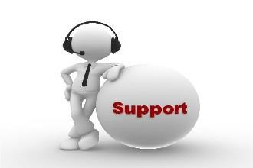

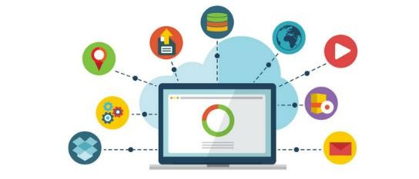
Cloud Computing - Challenges, Risk, and Mitigation
Impact of Cloud on IT Service Management
When moving to a cloud service model there are a number of considerations that affect IT service management.
Service Desk
In the cloud-computing model, high expectations of availability are a part of the model’s selling point, so rapid restoration of service becomes critical through the use of these processes and the Service Desk that performs them.
Change Management
Change Management workflow activities can be done best by the Service Delivery Architects. They are the ones who determine the rules used by the automation tools for the tasks performed traditionally by the Service management team.

Slide 53



Cloud Computing - Challenges, Risk, and Mitigation
Impact of Cloud on IT Service Management
Configuration and Asset Management
Configuration is easier in cloud than the enterprise IT model with an extensive variety of hardware and software to be orchestrated. Many service-specific tools provide configuration capability for that service, thus reducing the amount of manual coordination required.
Asset management is related to configuration management and, in a cloud service, has both
A virtual component—tracking virtual resources and
A dynamic component—assets can change every hour to its management process.
Asset Management needs to address:
A consumer view—what assets belong to the service being consumed
A service view—since assets equal revenue
An enterprise view—showing the business status of all cloud services being offered

Slide 54
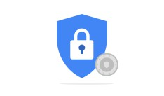




Cloud Computing - Challenges, Risk, and Mitigation
Impact of Cloud on IT Service Management
Service-Level Management
With a cloud environment, a single SLM process can exist, but separate SLAs and Service-Level Packages should be defined, monitored, and managed for each service.
Availability, Capacity, Continuity, and Security
The Cloud service provider must offer to its customers a warranty of service continuity and make it part of the SLA that comprises the Service-Level Packages offered by the service provider.
Scalability of capacity and performance are core offerings of cloud model and should be reflected in the SLAs.
For cloud services, availability is vital; much of the availability must be architected into the service.

Slide 55
Cloud Computing - Challenges, Risk, and Mitigation
Risks and Consequences of Cloud Computing
Legal Issues
Compliance Issues
Privacy and Security

Slide 56


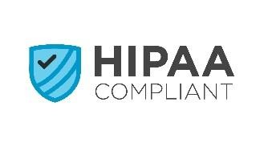
Cloud Computing - Challenges, Risk, and Mitigation
Legal and Compliance Issues
According to Glen Brunette and Rich Mogull of Cloud Security Alliance, in their white paper, “Security Guidance for Critical Areas of Focus in Cloud Computing.”
Cloud computing that employs a hybrid, community, or public cloud model “creates new dynamics in the relationship between an organization and its information, involving the presence of a third party: the cloud provider. This creates new challenges in understanding how laws apply to a wide variety of information management scenarios.”
If the tenant or cloud customer operates in the United States, Canada, or in the European Union, they are subjected to numerous regulatory requirements. These include Control Objectives for Information and related Technology and Safe Harbor. These laws might relate to where the data are stored or transferred, as well as how well these data are protected from a confidentiality aspect.
Some of these laws apply to specific markets, such as the Health Insurance Portability and Accountability Act (HIPAA) for the healthcare industry. However, companies often store health-related information about individual employees, which means those companies might have to comply with HIPPA even if they are not operating in that market.
56

Slide 57



Cloud Computing - Challenges, Risk, and Mitigation
Legal and Compliance Issues
Failure to adequately protect your data can have a number of consequences, including the potential for fines by one or more government or industry regulatory bodies. Such fines can be substantial and potentially crippling for a small or midsize business. For example, the Payment Card Industry (PCI) can impose fines of up to $100,000 per month for violations to its compliance. Although these fines will be levied onto the acquiring bank, they are likely to impact the merchant as well.
Third-Party Involvement
If you use a cloud infrastructure sourced from a cloud services provider, you must impose all legal or regulatory requirements that apply to your enterprise on your supplier as well. This is your responsibility, not the provider’s. Taking the HIPAA regulations as an example, any subcontractors
that you employ (for example, a cloud services provider) must have a clause in the contract stipulating that the provider will use reasonable security controls and also comply with any data privacy provisions.
57

Slide 58


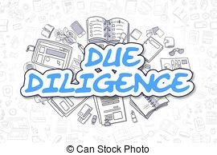
Cloud Computing - Challenges, Risk, and Mitigation
Legal and Compliance Issues
Contractual Issues
These are some of the issues you must consider at all stages of the contractual process:
Initial due diligence
Contract negotiation
Implementation
Termination (end of term or abnormal)
Supplier transfer
Initial Due Diligence
Prior to entering into a contract with a cloud supplier, your enterprise should evaluate its specific needs and requirements. You should define the scope of the services you are looking for, along with any restrictions, regulations, or compliance issues that need to be satisfied. For instance, if you are going to collect and store employee HIPAA data in the cloud, you must ensure that any supplier will meet the guidelines defined by the HIPAA regulations. Assessing the different laws and regulations your enterprise needs to abide by may well define what you can deploy in a cloud or which type of service you can use.
58

Slide 59
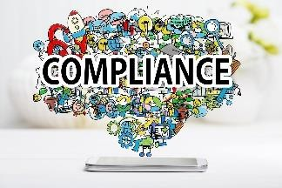

Cloud Computing - Challenges, Risk, and Mitigation
Compliance Issues
Data compliance is critical in the cloud and is in fact a major area of concern for organizations moving to the cloud. Compliance in the cloud can be categorized into two types:
Geographic compliance:
With the flow of personal data across borders, geographic locations play a vital role in the storage and processing of data. For instance, what may seem right in the US may be a breach in Canada or Europe.
Also different regions within the same country may follow a different set of compliance measures.

Slide 60

Cloud Computing - Challenges, Risk, and Mitigation
Compliance Issues
Industry compliance:
Some industries like healthcare and finance pose very stringent compliance measures while working in the cloud. These compliance measures are practiced to make the regulation of sensitive data more centralized. To avoid any legal issues that might arise from compliance matters, organizations must,
Analyze the data to be moved to the cloud. Data that are prone to maximum risk must be kept internal or in the private cloud.
Draw a compliance checklist and ensure the cloud provider has the capabilities to protect data with the
right compliance framework.
Conduct an audit to ensure that compliance measures offered by the provider have been implemented in real.

Slide 61
Cloud Computing - Challenges, Risk, and Mitigation
Data Privacy and Security Issues
With a third party organization managing the infrastructure in the cloud, the responsibility to maintain privacy of all personal data are enhanced. It is common and acceptable to share personal data with the cloud but the decision must be an informed one.
Personal details of employees, customer data and company secrets must be protected against the potential risks
of theft and leakage.
The different elements that needs to be made available in contracts and agreements while moving to the cloud are:
Privacy and Data Protection
According to a research by IDC (International Data Corporation), 71% of enterprises say preventing the exposure of confidential data and related information is one of their top challenges.
The research also pin points that the company’s financial and customer information, intellectual properties and personal information of employees are the most vulnerable data.

Slide 62
Cloud Computing - Challenges, Risk, and Mitigation
Data Privacy and Security Issues
Privacy and Data Protection
Data that can be traced back to a single individual can be categorized as a “personal”. Companies must
look for cloud service providers that offer sufficient protection to such sensitive information.
To start with, when third party data have to be moved to the cloud, the existence of any contracts or obligations against such action must be checked.
Following this, depending on the location of the cloud service provider and industry-specific laws of privacy such as Health Insurance Portability and Accountability Act (HIPAA) or the Gramm- Leach-Bliley Act (GLBA), stringent privacy measures must be applied.

Slide 63
Cloud Computing - Challenges, Risk, and Mitigation
Data Privacy and Security Issues
Data Controllers and Data Processors
In order to regulate the use of personal data, the Data Protection Act was established. Under this act,
the data controller implies to an entity that determines the purpose of holding personal data, and the
data processor “processes” the data on behalf of the controller.
The data controller takes the ultimate responsibility of complying with the Data Protection Act in case of any discrepancies.
Though the cloud service provider is often the data processor, there are some cases where it takes the role of a data controller too.
The precise role of the cloud service provider must be evaluated in each case and the obligation for data protection must be assigned to the right entity.

Slide 64
Cloud Computing - Challenges, Risk, and Mitigation
Data Privacy and Security Issues
With the role of the data controller and data processor defined and the level of obligation stated, cloud customers must now evaluate the technical aspects of the provider and learn how they promise to deliver services within the established expectations of protection.
Failing this, the following data protection issues can be expected in the cloud environment:
Lack of interoperability and data portability.
Lack of integrity that arises from sharing of resources.
Inability to ensure data compliance measures.
Lack of proper data isolation in the multitenant environment.
Data protection risks are further amplified when the cloud service provider involves multiple tiers of sub-processors/sub-contractors and data transfer happens between different countries.

Slide 65
Cloud Computing - Challenges, Risk, and Mitigation
Data Privacy and Security Issues
Data Protection Laws
Prior to 2011, the Indian judiciary system did not provide space for clear-cut laws pertaining to data protection. However, with the enhancement of data protection laws in the European Union, Information Technology Rules, 2011, came into place.
Under this act, corporate bodies, Indian government, and information providers were subjected to sensible security practices.
In addition, there are other laws within the Indian Penal Code (IPC) that can assist in practicing a reasonable level of security while handling data in the cloud.

Slide 66
Cloud Computing - Challenges, Risk, and Mitigation
Data Privacy and Security Issues
Laws that protect data in India
Law/Act/Rights | Explanation
The Information Technology Act (Section 43A) | When a corporate body causes a “wrongful loss or wrongful gain” due to its negligence in maintaining a fair level of security of data, then it is liable to pay the compensation to the person affected.
The Information Technology Act(Section 72 A) | Privacy breach may result in imprisonment for up to 3 years and the penalty may extend up to five lakhs.
Right to Privacy (Article 19 and 21) | Right to privacy (applicable to data privacy as well)

Slide 67
Cloud Computing - Challenges, Risk, and Mitigation
Self-Assessment Question
1. How can you define personal data?
Passwords and Logins
Information that can help identify an individual
Information that helps laundering money
Any information pertaining to personal email and social network accounts
Answer: B

Slide 68
Cloud Computing - Challenges, Risk, and Mitigation
Self-Assessment Question
Compliance in the cloud can be of two types. They are,
Geographic and Data Type
Geographic and Industry Specific
Industry Specific and Data Types
Compliance cannot be categorized
Answer: B

Slide 69
Cloud Computing - Challenges, Risk, and Mitigation
Self-Assessment Question
One common risk that arises from lack of data protection in the cloud is
Lack of good data
Lack of data integrity
Loss of money
None of the above
Answer: B

Slide 70
Cloud Computing - Challenges, Risk, and Mitigation
Self-Assessment Question
HIPAA is a compliance measure practiced in the industry
Finance
Banking
Healthcare
Food Administration
Answer: C

Slide 71
Cloud Computing - Challenges, Risk, and Mitigation
Self-Assessment Question
According to the Data Protection Act, a data controller
Takes complete responsibility of the data protection in the cloud.
Shares its responsibility of data protection with other entities.
Processes data on behalf on the data processor.
Is the same as a data processor.
Answer: A

Slide 72
Cloud Computing - Challenges, Risk, and Mitigation
Self-Assessment Question
The phased-in approach is recommended over the flash-cut approach because,
It eliminates the psychological barrier of giving up control over organizational resources and data.
It aids in better cost savings and higher efficiency.
Phased-in approach cleanses data and helps modernize applications.
It is recommended by cloud experts across the world.
Answer: A

Slide 73
Cloud Computing - Challenges, Risk, and Mitigation
Self-Assessment Question
Which one of the following must be avoided while moving to the cloud?
Security measures
Cloud Governance
Due-diligence
Jumping in too soon
Answer: D

Slide 74
Cloud Computing - Challenges, Risk, and Mitigation
Self-Assessment Question
One of the common concerns about cloud computing is
Ongoing costs
Adapting to the new environment
Compliance issues
Lack of expertise
Answer: C

Slide 75
Cloud Computing - Challenges, Risk, and Mitigation
Self-Assessment Question
is a service model in which data is maintained, managed, backed up remotely, and made available to users over a network.
Cloud storage
Cloud security
Answer: A

Slide 76
Cloud Computing - Challenges, Risk, and Mitigation
Self-Assessment Question
The three cloud-based architecture models are:
Public, private, and industry
Public, private, and hybrid
Public, private, and community
Public, hybrid, and industry
Answer: B

Slide 77
Cloud Computing - Challenges, Risk, and Mitigation
Self-Assessment Question
The storage service that provides a dedicated environment protected behind a firewall is .
Public
Hybrid
Private
Community
Answer: C

Slide 78
Cloud Computing - Challenges, Risk, and Mitigation
Self-Assessment Question
12. Data integrity is:
Maintaining and assuring the accuracy and completeness of data.
Maintaining a backup copy of the data.
Answer: A

Slide 79
Cloud Computing - Challenges, Risk, and Mitigation
Self-Assessment Question
The responsibility of cloud security lies with:
Provider only
Customer only
Both provider and customer
None
Answer: C

Slide 80
Cloud Computing - Challenges, Risk, and Mitigation
Self-Assessment Question
Select the option that is NOT the responsibility of the cloud vendor:
Authenticate all users
Ensure thorough background checks of all employees who have physical access to the servers
Ensure data isolation and logical storage segregation
Manage and secure the virtualization layer
Answer: A

Slide 81
Cloud Computing - Challenges, Risk, and Mitigation
Self-Assessment Question
Select the option that is true when designing a cloud proof of concept.
Always choose the most complex application
Check to see if the architecture meets the needs of the data center, not if it matches the application
Try to recreate your data center in the cloud
Keep it lightweight, 30–60 days.
Answer: D

Slide 82
Cloud Computing - Challenges, Risk, and Mitigation
Self-Assessment Question
Private clouds are a good choice for applications that require:
Flexibility
Performance
Scalability
Increased security and compliance
i, ii, and iii
i, ii, and iv
i and iii
ii and iii
Answer: B

Slide 83
Cloud Computing - Challenges, Risk, and Mitigation
Self-Assessment Question
Most vendors have an automatic contract renewal clause which is very-well suited to all organizations.
True
False
Answer: B

Slide 84
Cloud Computing - Challenges, Risk, and Mitigation
Self-Assessment Question
Different countries have different laws that govern where data can be stored for services provided in that geographical span.
True
False
Answer: A

Slide 85
Cloud Computing - Challenges, Risk, and Mitigation
Self-Assessment Question
Partnering with more than one cloud vendor to satisfy all business needs:
Is a bad practice
Helps the organization avoid downtime issues
Answer: B

Slide 86
Cloud Computing - Challenges, Risk, and Mitigation
Self-Assessment Question
Configuration management is easier in cloud because:
Most of the systems are virtual
Cloud needs little configuration management
Many service-specific tools provide configuration capability for that service
Configuration management is the responsibility of the customer
Answer: C

Slide 87
Cloud Computing - Challenges, Risk, and Mitigation
Self-Assessment Question
HIPPA stands for .
Health Insurance Portability and Accountability Act
Health Insurance Portability and Accessibility Act
Answer: A

Slide 88
Cloud Computing - Challenges, Risk, and Mitigation
Self-Assessment Question
Different regions within the same country may follow a different set of compliance measures.
True
False
Answer: A

Slide 89
Cloud Computing - Challenges, Risk, and Mitigation
Self-Assessment Question
The data protection act was established to regulate:
Use of public records
Use of government records
Use of personal data
Use of corporate data
Answer: C

Slide 90
Cloud Computing - Challenges, Risk, and Mitigation
Self-Assessment Question
Under data protection act, a data controller implies the entity:
That processes the data
That determines the purpose of holding the personal data
Answer: B

Slide 91
Cloud Computing - Challenges, Risk, and Mitigation
Self-Assessment Question
Sharing of resources in the cloud can lead to:
Lack of interoperability
Lack of data portability
Inability to ensure data compliance measures
Lack of integrity
Answer: B

Slide 92
Cloud Computing - Challenges, Risk, and Mitigation
Self-Assessment Question
Under law a privacy breach may result in imprisonment for up to 3 years and penalty that may extend up to five lakhs.
The Information Technology Act (Section 43A)
The Information Technology Act (Section 72A)
Answer: B

Slide 93
Cloud Computing - Challenges, Risk, and Mitigation
Assignment
You need to answer below sets of problem. These sets of questions are meant for testing unit IV.
Define the three types of cloud storage.
Discuss the ways in which cloud security breaches can be reduced.
Explain the considerations involved in designing a cloud proof of concept.
Outline vendor roles and responsibilities in cloud.
Discuss the impact of Cloud on IT service management.
Explain the best practices when negotiating a cloud contract.
Discuss the legal and compliance issues involved when moving to cloud.
Explain data privacy and security risks in cloud and how to mitigate them.

Slide 94
Introduction to Operating System
Summary
Cloud storage is a service model in which data are maintained, managed, backed-up remotely, and
made available to users over a network.
Public storage services provide a multi-tenant storage environment that is most suited for unstructured data.
Private cloud, or on premise, storage services provide a dedicated environment protected behind an organization's firewall.
Hybrid cloud is a mix of private cloud and third-party public cloud services with orchestration
between the platforms for management.
Data storage in a SaaS solution is done by the service provider. Due to that, if you are migrating an existing application to a SaaS application, you need to work with the vendor to plan how data will be migrated from the current on-premises solution to the new SaaS solution.
Even when cloud operators have good security (physical, network, OS, application infrastructure), it
is the company’s responsibility to protect and secure applications and information.
Cloud computing gives businesses the opportunity for immediate launching of applications. When moving to cloud its always a good idea to first design a proof of concept.

Slide 95
Introduction to Operating System
Summary
The service agreement must include a list of roles and responsibilities for both the customer and the
cloud service vendor.
Even with the SLA and other assurances in place, it is recommended to have insurance coverage in case there is an interruption to the organization’s business due to the inability of the vendor to maintain the necessary service terms.
The data stored should be the property of the company, not the vendor.
Complexities while migrating to the cloud vary from one organization to the other. However, partnering with a reliable cloud service provider and planning ahead will deliver higher chances for optimized performance through the cloud.
Data compliance is critical in the cloud and is in fact a major area of concern for organizations moving to the cloud. Compliance in the cloud can be categorized into two types: Geographic compliance and Industry compliance.

Slide 96
Cloud Computing - Challenges, Risk, and Mitigation
Document Links
Topics | URL | Notes
Cloud Storage | https://searchstorage.techtarget.com/definition/ cloud-storage | This link explains cloud storage using use cases.
Cloud Security | https://searchcompliance.techtarget.com/definit ion/cloud-computing-security | This link discusses cloud security.
Designing a cloud proof of concept | https://www.rightscale.com/blog/enterprise- cloud-strategies/six-tips-choosing-cloud-proof- concept-application | This link highlights the important things to consider while designing a cloud proof of concept.
Impact of Cloud on IT Service Management | https://www.knowledgehut.com/blog/cloud- computing/impact-service-management-cloud- computing | The link explains the impact of cloud on IT service management.
Cloud Computing Legal Issues | https://technet.microsoft.com/en- us/library/hh994647.aspx | The link discusses the legal and regulatory issues of cloud computing.

Slide 97
Introduction to Operating System
Video Links
Topics | URL | Notes
Cloud Storage | https://www.youtube.com/watch?v=c5q6qwp_ mEM | This video explains cloud storage using use cases.
Cloud Security | https://www.youtube.com/watch?v=L-cC-JjYos0 | This video discusses cloud security.
Impact of Cloud on IT Service Management | https://www.youtube.com/watch?v=uXn7PB4wlU4 | The video explains the impact of cloud on IT service management.
Cloud Computing Legal Issues | https://www.youtube.com/watch?v=Te44cpq7LPM | The video discusses the legal and regulatory issues of cloud computing.
Cloud computing security issues | https://www.youtube.com/watch?v=wI84CjHMKhk | This video explains the security issues of cloud computing.

Slide 98
Cloud Computing - Challenges, Risk, and Mitigation
E-Book Links
Topics | URL | Page Number
Vendor roles and responsibilities | http://www.nortonaudio.com/Ficheiros/111840873X_Cloud.pdf | Page 141-144

